Slide 1

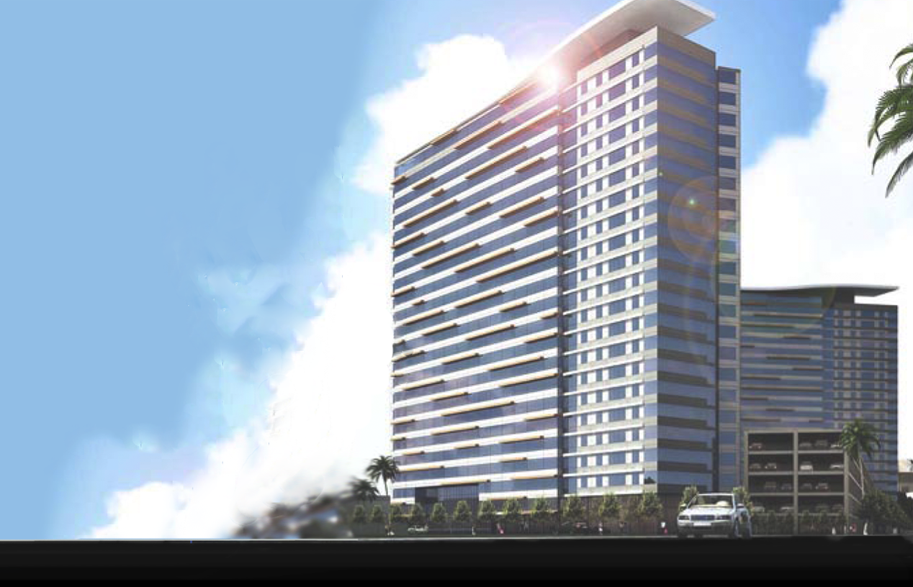



Slide 2
Building Background
Building Structural System
Problem Statement
Proposed Solution
Structural Investigations
Architectural Impact
Sustainability Study
Conclusion
Notes:
Discuss outline
3 breadths: Arch, Sustain, and CM; Will not be discussing CM in detail for this presentation due to time constraints

Slide 3
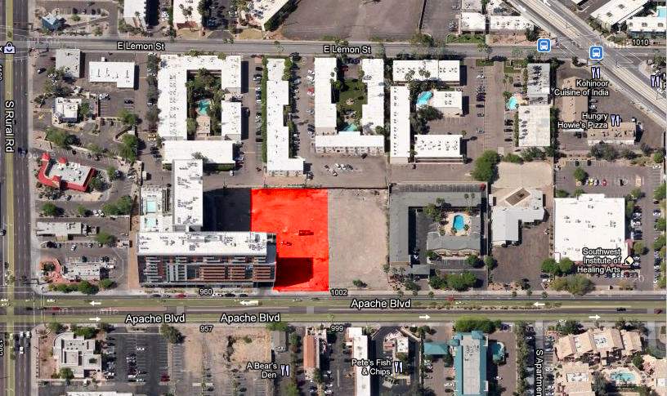
Building Background
Site Map
Building Background
Building Structural System
Problem Statement
Proposed Solution
Structural Investigations
Architectural Impact
Sustainability Study
Conclusion
Client: Arizona State University
New 20-story apartment building
Overall height: 208 ft
Total area: 260,000 ft²
Estimated total cost: $37.5 million
Projected construction time: 177 days (9 months)
Notes:
268 apartment units (Studio, 1BR, 2BR, 3BR and 4BR)
528 beds
Location:
No snow loads, low seismicity
Urban site, previously developed, within 400 feet of 5 bus stops
Sunny, lots of access to daylighting

Slide 4

Building Background
Unique Features
Typical Floor Plan
Building Background
Building Structural System
Problem Statement
Proposed Solution
Structural Investigations
Architectural Impact
Sustainability Study
Conclusion
Modular
Uses prefabricated assemblies
Slip-formed concrete cores
No columns
Erected using Lift Slab Construction
    - L’Ambiance Plaza, 1987
Notes:
Long floor plan, 52’x250’
Almost square bays (13’x12.5’)
Floor is split into pre-assembled modules, where quantities of pre-plumbed, pre-wired walls are brought in to area specs
bathrooms come entirely prefabricated

Slide 5
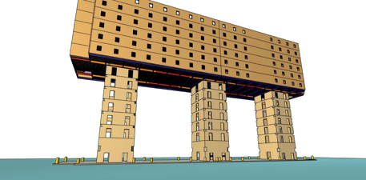
Building Background
Unique Features
Lift-Slab Construction
Building Background
Building Structural System
Problem Statement
Proposed Solution
Structural Investigations
Architectural Impact
Sustainability Study
Conclusion
Modular
Uses prefabricated assemblies
Slip-formed concrete cores
No columns
Erected using Lift Slab Construction
    - L’Ambiance Plaza, 1987
Notes:
Lift-slab is unusual because few construction projects in the US have been built using this method since the collapse of L’Ambiance Plaza, which killed 28 people
Lift-slab is a fast and effective method for quickly erecting regular structures
Premise:
Cores come first
Top floor is lifted (one half 2 a time) into place using strand jacks @ the corners of every core
Point out seam in the middle of each floor
Floors are attached to core via a wide flange (see appendix)
Cladding is lifted with each floor
Idea – have it be as hands off as possible, with as few workers ever in the air as possible, and avoid the need for a crane

Slide 6
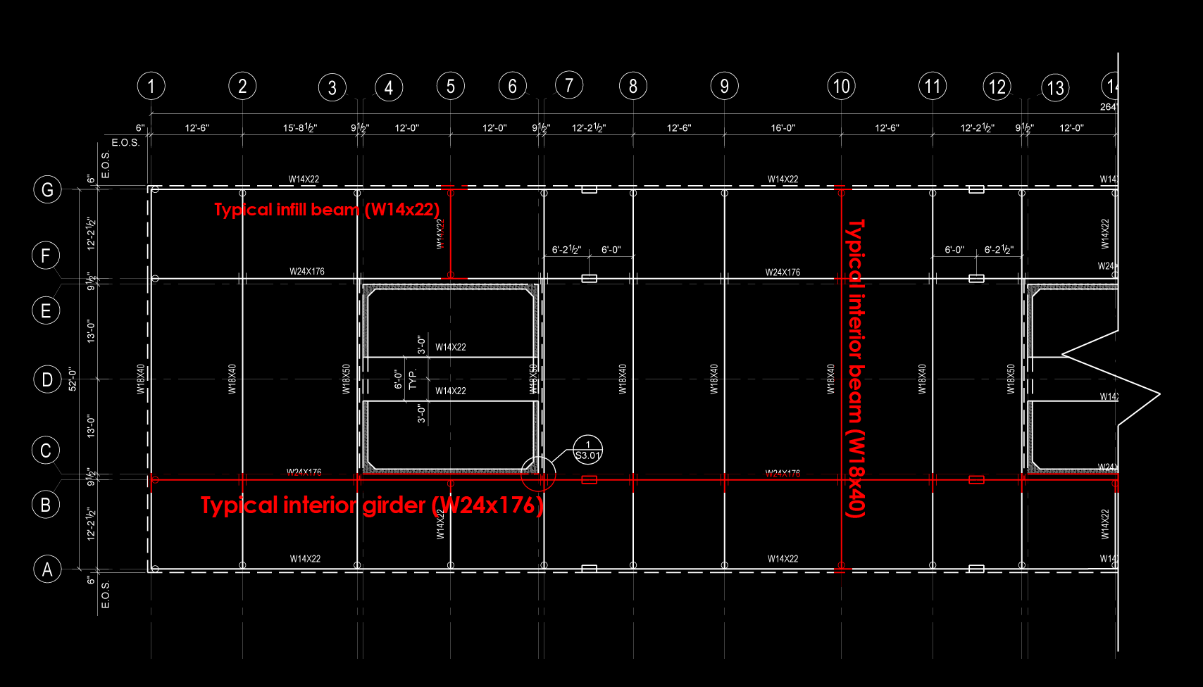
Building Structural System
Structural Framing Plan
Building Background
Building Structural System
Problem Statement
Proposed Solution
Structural Investigations
Architectural Impact
Sustainability Study
Conclusion
Mat Foundation
    - Soil conditions
Floor System
    - Structural steel framing
    - 3” metal deck
    - 3-1/4” lightweight concrete topping
Notes:
Soils report says “deep foundations”
Owner/contractor plans on making an argument for mat foundations
Floor system is noncomposite
3000 psi concrete
Every structural steel member is cambered, up to 4” at the cantilevered end of the interior girders, to adhere to serviceability requirements
Steel is assembled, and concrete is poured over half of the floor in 2 days, then the floor is immediately lifted

Slide 7
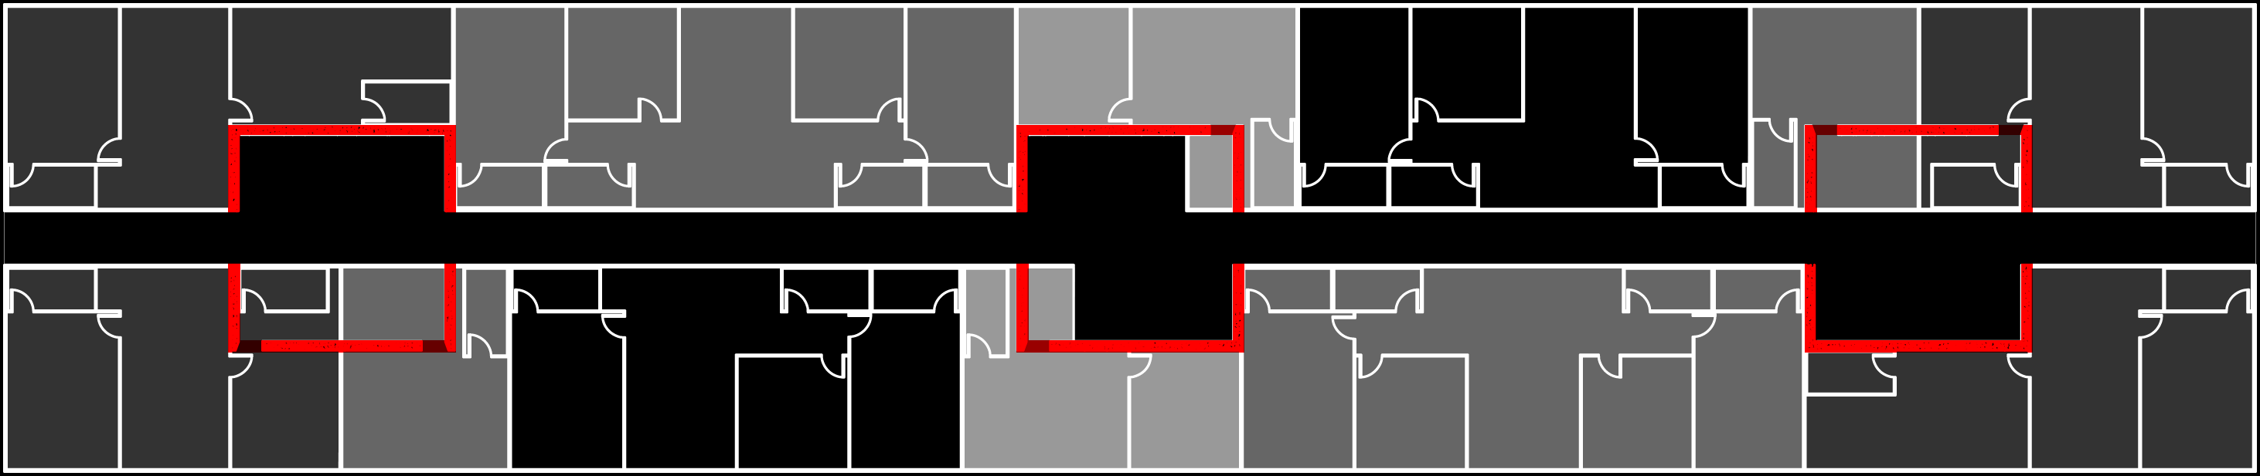
Building Structural System
(3) 25’ x 25’ Concrete Cores
Building Background
Building Structural System
Problem Statement
Proposed Solution
Structural Investigations
Architectural Impact
Sustainability Study
Conclusion
Gravity and Lateral system
    Gravity:
    Lateral:
    V_{base} = 235k
    V_{wind} = 565k
    Maximum drift = 2.74 in (h/400 = 6.24 in)
Notes:
Cores are both the lateral and gravity system
No columns
Floors are cantilevered off of the cores, which function as just point load supports @ corners
2’ deep coupling beams @ openings
25’ x 25’ cores, 8” thick
F’c = 4000
Minimum ACI 318 reinforcing requirements

Slide 8
Problem Statement
Building Background
Building Structural System
Problem Statement
Proposed Solution
Structural Investigations
Architectural Impact
Sustainability Study
Conclusion
How versatile is this construction method?

Slide 9
Problem Statement
Building Background
Building Structural System
Problem Statement
Proposed Solution
Structural Investigations
Architectural Impact
Sustainability Study
Conclusion
How versatile is this construction method?
How easily could it be redesigned for higher seismic loads?
  How would the connection of the floor system to the core need to change?

Slide 10
Problem Statement
Building Background
Building Structural System
Problem Statement
Proposed Solution
Structural Investigations
Architectural Impact
Sustainability Study
Conclusion
How versatile is this construction method?
How easily could it be redesigned for higher seismic loads?
  How would the connection of the floor system to the core need to change?
How does the construction cost fluctuate for more extreme loading conditions?

Slide 11
Problem Statement
Building Background
Building Structural System
Problem Statement
Proposed Solution
Structural Investigations
Architectural Impact
Sustainability Study
Conclusion
How versatile is this construction method?
How easily could it be redesigned for higher seismic loads?
  How would the connection of the floor system to the core need to change?
How does the construction cost fluctuate for more extreme loading conditions?
What effect would the redesign have on the floor plan?

Slide 12
Problem Statement
Building Background
Building Structural System
Problem Statement
Proposed Solution
Structural Investigations
Architectural Impact
Sustainability Study
Conclusion
How versatile is this construction method?
How easily could it be redesigned for higher seismic loads?
  How would the connection of the floor system to the core need to change?
How does the construction cost fluctuate for more extreme loading conditions?
What effect would the redesign have on the floor plan?
How easily can this type of building attain a LEED Certification in a cost-effective way?

Slide 13
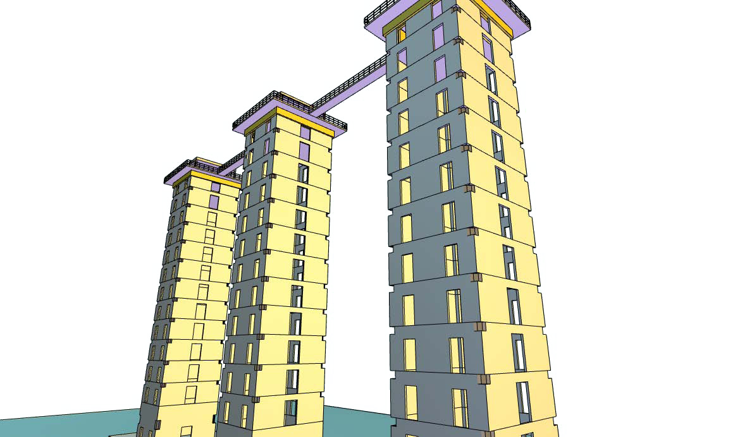
Proposed Solution
Core Openings in the Original Design
Building Background
Building Structural System
Problem Statement
Proposed Solution
Structural Investigations
Architectural Impact
Sustainability Study
Conclusion
Relocate to SDC D
  St Louis, Missouri
Investigate ways to transfer diaphragm shear to the cores
Cost analysis
Architectural evaluation
Sustainability study
Notes:
Relocate to SDC D:
why st louis? – with a change of the site class to D, the building enters the lower spectrum of SDC D forces
Want to check under high seismic conditions, but not EXTREME conditions like those found in, for example, Alaska
Diaphragm shear: current system? Would NOT work for a region of high seismicity;
would need to design a special seismic connection from the floor diaphragm to the cores
Cost analysis would include a brief examination of the effect on the schedule (would use Tempe, AZ costs to make the buildings comparable)
Architectural eval would be necessary bc the core structure would need to change- too many openings (see picture)- would cause stress concentrations and mess with the stiffness
THUS the floor plan would need to be altered to accommodate greatly limited core access (say, only the corridor and otherwise continuous walls)
Sustainability study- aim at minimizing cost investment, because that would appeal to most owners that are paying for construction
there are many credits that only require planning ahead and being choosier with the material choices for finishes, adhesives, furniture, etc

Slide 14
Structural Investigations
Building Background
Building Structural System
Problem Statement
Proposed Solution
Structural Investigations
Architectural Impact
Sustainability Study
Conclusion
New design loads:
Special reinforced concrete shear walls
Assumption: no extreme torsional irregularity (ASCE 7-05, 12.2.5.4)
C_{s,new} = 0.027
W_{bldg,new} = 24,349 kips
Trial sizing: 12” , 16” and 18” walls
  Used 16” walls for building weight
Shear check: t_{min} = 9.26 in
Notes:
New design loads-
St Louis turned out to have the same wind loads as Tempe, AZ;
there was no change to the gravity loads, except for one major difference: st louis has snow load
base shear increased with the transition from SDC B to SDC D
Structure is special reinforced concrete shear walls
Took height limit except in 12.2.5.4 (otherwise, only allowed to be 100 ft tall)
Base shear was attained using new Cs for location, and the weight of the bldg with 16” walls and 3’ deep coupling beams
Chose a range of initial sizes to try, modeled them in ETABS with their respective masses to look @ performance, went with 16” walls (preferred for having more room for the coupling beams anyway)
Found minimum thickness for concrete to resist all shear; chose to continue with 16” walls

Slide 15

Structural Investigations
Core Design
Building Background
Building Structural System
Problem Statement
Proposed Solution
Structural Investigations
Architectural Impact
Sustainability Study
Conclusion
Reinforcement details:
Trial wall thickness = 16”
Minimum shear reinforcement
  V_{c} = 2678k >> V_{base} = 1001k
Minimum moment reinforcement
Boundary elements
Maximum compressive stress = 0.253f’_{c}
Notes:
Again, stuck with 16” because of coupling beams
Since t > tmin, Vc>>Vbase so just needed the minimum shear reinforcement req
***Not pictured is the transverse reinforcement, which is #4’s @ 3” o.c.
Boundary elements were included “to maintain structural integrity under seismic lateral loads when also holding gravity loads”
Maximum compressive stress was under 120% of design overturning moment (to account for torsion)

Slide 16

Structural Investigations
Core Design
Building Background
Building Structural System
Problem Statement
Proposed Solution
Structural Investigations
Architectural Impact
Sustainability Study
Conclusion
Reinforcement details:
Trial wall thickness = 16”
Minimum shear reinforcement
  V_{c} = 2678k >> V_{base} = 1001k
Minimum moment reinforcement
Boundary elements
Maximum compressive stress = 0.253f’_{c}
Notes:
Again, stuck with 16” because of coupling beams
Since t > tmin, Vc>>Vbase so just needed the minimum shear reinforcement req
Boundary elements were included “to maintain structural integrity under seismic lateral loads when also holding gravity loads”
Maximum compressive stress was under 120% of design overturning moment (to account for torsion)

Slide 17

Structural Investigations
Core Design
Building Background
Building Structural System
Problem Statement
Proposed Solution
Structural Investigations
Architectural Impact
Sustainability Study
Conclusion
Reinforcement details:
Coupling beams
  Shear from ETABS model:
    V_{max,model (3rd floor)} = 130.7 kips
    V_{coupling beam design} =158 kips
Notes:
For coupling beams:
Methodology- took 80% of max shear modeled @120% of design shear (ASSUME the shear will be distributed bc of cracking)
used eqn’s from ch21 for Mpr- divided 0.8V*0.5L by 0.9 to change phi to 1.0, then multiplied by 1.25/(0.5L) to get design shear of 158k

Slide 18

Structural Investigations
Core Design
Core Shapes
Building Background
Building Structural System
Problem Statement
Proposed Solution
Structural Investigations
Architectural Impact
Sustainability Study
Conclusion
Modeling
  3 models (different core layouts)
    - Original design
    - Option 1(minimal openings)
    - Option 2 (consolidated openings)
Notes:
3 models in order to allow more experimentation with the architectural layout
Original- lots of smaller openings close to the corners, prone to stress concentrations and lower stiffness

Slide 19

Structural Investigations
Core Design
Core Shapes
Building Background
Building Structural System
Problem Statement
Proposed Solution
Structural Investigations
Architectural Impact
Sustainability Study
Conclusion
Modeling
  3 models (different core layouts)
    - Original design
    - Option 1(minimal openings)
    - Option 2 (consolidated openings)
Notes:
Option 1 has continuous walls, no openings, will be the most stiff laterally and torsionally

Slide 20

Structural Investigations
Core Design
Core Shapes
Building Background
Building Structural System
Problem Statement
Proposed Solution
Structural Investigations
Architectural Impact
Sustainability Study
Conclusion
Modeling
  3 models (different core layouts)
    - Original design
    - Option 1(minimal openings)
    - Option 2 (consolidated openings)
Notes:
Option 2 was included because having central openings and symmetric cores can be beneficial for the stress distribution and wall stiffness
Additionally, it leaves corners free for boundary elements

Slide 21
Structural Investigations
Core Design
ETABS Outputs
Building Background
Building Structural System
Problem Statement
Proposed Solution
Structural Investigations
Architectural Impact
Sustainability Study
Conclusion
Modeling
  3 models (different core layouts)
    - Original design
    - Option 1(minimal openings)
    - Option 2 (consolidated openings)

Slide 22
Structural Investigations
Floor System Design
Building Background
Building Structural System
Problem Statement
Proposed Solution
Structural Investigations
Architectural Impact
Sustainability Study
Conclusion
2 potential designs:
  “Steel Collar” Design
    Shear goes directly from diaphragm to core via shear studs embedded in the core
  “Drag Strut” Design
    The beams running along each core act as collector elements, shear transfer is from beams to core via welds on elements embedded in core
Focus: floor-to-core connection
  Shear transfer
Complexity
  Coupling beams
  Boundary elements
  Construction method
Notes:
Floor to core connection is crucial in order to provide adequate shear transfer from the floor diaphragm to the concrete cores when the building is subjected to seismic loading
Additional complexity comes from:
needing to keep the coupling beams open in order to maintain predictable behavior under lateral loads
having to deal with no space at the corners of the core bc of boundary elements clogging everything
needing to be able to lift the floor smoothly up the core, no interruptions (nothing sticking off of core) in order to maintain lift-slab
Came up with 2 potential designs, both with many pros and cons, both have the con of being difficult to construct

Slide 23


Structural Investigations
Floor System Design
Building Background
Building Structural System
Problem Statement
Proposed Solution
Structural Investigations
Architectural Impact
Sustainability Study
Conclusion
2 potential designs:
  “Steel Collar” Design
    Shear goes directly from diaphragm to core via shear studs embedded in the core
  “Drag Strut” Design
    The beams running along each core act as collector elements, shear transfer is from beams to core via welds on elements embedded in core
Notes:
Steel collar design-
Studs, steel plate, studs @ 4” oc on interior of core and 6” oc on exterior of core
Curb is a result of Appendix D spot checks for concrete tearout due to tension and shear, as well as concrete pryout
Cons: time consuming, a lot of steel, would need to have a large amount prefabricated, would have welders in mid-air

Slide 24
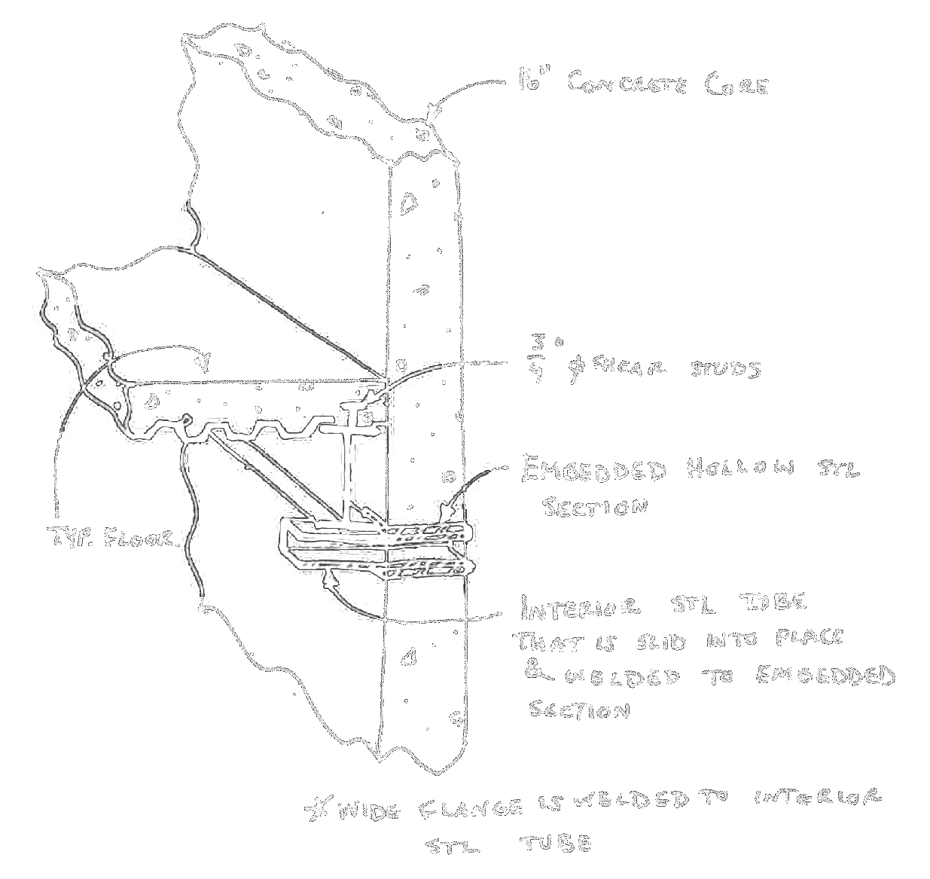
Structural Investigations
Floor System Design
Building Background
Building Structural System
Problem Statement
Proposed Solution
Structural Investigations
Architectural Impact
Sustainability Study
Conclusion
2 potential designs:
  “Steel Collar” Design
    Shear goes directly from diaphragm to core via shear studs embedded in the core
  “Drag Strut” Design
    The beams running along each core act as collector elements, shear transfer is from beams to core via welds on elements embedded in core
Notes:
Drag strut design
Shear studs on beams and girders to transfer shear from concrete to beam, and from beam directly to core
Pros: no concrete curb
Cons: would need to sort out how to fit the tubes in with the boundary elements, also would require having welders in mid-air, would need additional reinforcement in the floor diaphragm to ensure shear transfer to the collector element

Slide 25
Structural Investigations
Cost Evaluation
Building Background
Building Structural System
Problem Statement
Proposed Solution
Structural Investigations
Architectural Impact
Sustainability Study
Conclusion
Used bare material costs for evaluation
About the same for both options
Additional 8% of total construction cost
Notes:
No labor costs or equipment costs, why?
Because of the unusual nature of this project’s construction, I felt that the RS means labor costs were probably inaccurate
Would it be reasonable to assume that labor costs are the same as the material costs??
Showing base material costs, there’s more to the materials takeoffs

Slide 26
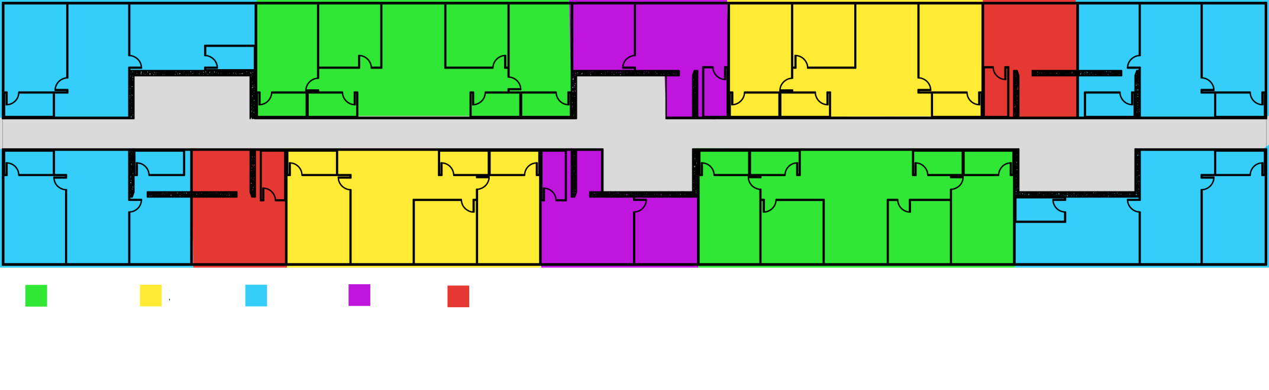
Architectural Impact
Original Design
Building Background
Building Structural System
Problem Statement
Proposed Solution
Structural Investigations
Architectural Impact
Sustainability Study
Conclusion
Advantages
  Easy access to cores
  Regular
  Modular
Disadvantages
  Numerous core penetrations
Patterns
  Bathrooms line the corridor
Notes:
Original design:
Point out modules (next slide)

Slide 27
Architectural Impact
Original Design
Building Background
Building Structural System
Problem Statement
Proposed Solution
Structural Investigations
Architectural Impact
Sustainability Study
Conclusion
Advantages
  Easy access to cores
  Regular
  Modular
Disadvantages
  Numerous core penetrations
Patterns
  Bathrooms line the corridor
Notes:
Penetrations cause stress concentrations, more coupling beams add to reinforcement cost and details
Bathrooms lining corridor is important- easy plumbing when the floor sections come with everything pre-assembled

Slide 28
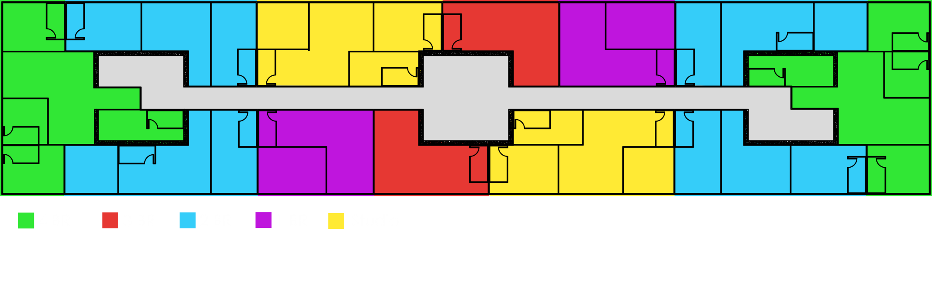
Architectural Impact
Option 1
Building Background
Building Structural System
Problem Statement
Proposed Solution
Structural Investigations
Architectural Impact
Sustainability Study
Conclusion
Advantages
  No core penetrations
  More usable area
Disadvantages
  Not as regular
  Bathrooms are not as stacked
Notes:
Option 1:
Not conducive to modularity if it’s not as regular

Slide 29
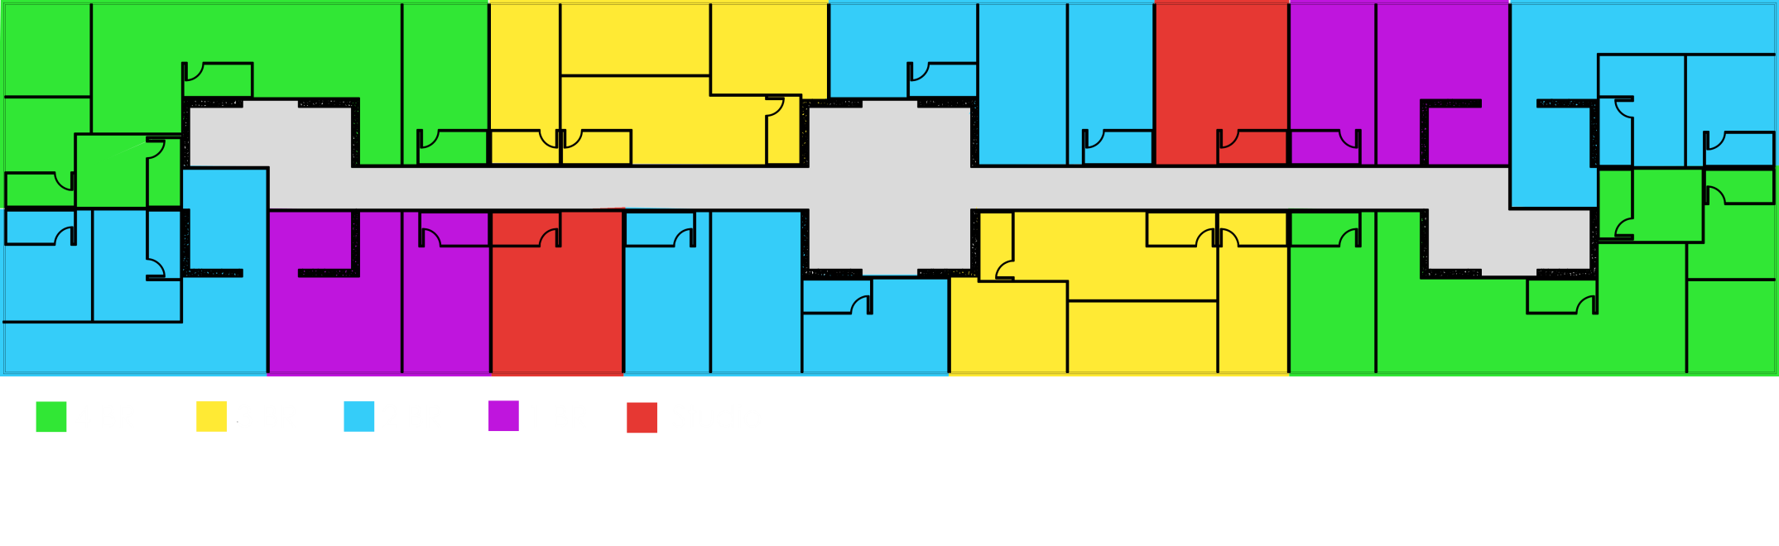
Architectural Impact
Option 2
Building Background
Building Structural System
Problem Statement
Proposed Solution
Structural Investigations
Architectural Impact
Sustainability Study
Conclusion
Advantages
  Easy access to cores
  Modular
  More usable area
  Bathrooms are more stacked
Disadvantages
  Core penetrations
Notes:
Option 2:
Biggest con is the core penetrations
while they are more optimized to maximize stiffness and symmetry, the overall stiffness is still lower than Option 1; more torsional problems, higher modes and deflections

Slide 30

Sustainability Study
Goal
Building Background
Building Structural System
Problem Statement
Proposed Solution
Structural Investigations
Architectural Impact
Sustainability Study
Conclusion
Attain a minimum of LEED Certified status with minimal, if any, cost investment
  LEED Certified status requires a minimum of 40 points

Slide 31
Sustainability Study
LEED Point Evaluation
Building Background
Building Structural System
Problem Statement
Proposed Solution
Structural Investigations
Architectural Impact
Sustainability Study
Conclusion
Current design = 20 points
Additional easily attainable points = 21
  3 of the 21 credits require money
    - Sheltered bike racks for 15% of residents
    - Landscaping to protect, restore and shade the site
Notes:
Did not consider energy and atmosphere credits (35/110 pts, 32% of the credits)
couldn’t verify whether the building met the prerequisites
Of easily attainable points, most just require planning ahead
ie, using a white EPDM covering instead of a black one
investing in recycled wood products for doors and casework and room finishes
researching which adhesives and paints are low E
making waste management plans for construction duration
sending out surveys to the residents by letter or email to make sure they’re comfortable with the thermal levels in the building

Slide 32
Sustainability Study
LEED Point Evaluation
Building Background
Building Structural System
Problem Statement
Proposed Solution
Structural Investigations
Architectural Impact
Sustainability Study
Conclusion
Current design = 20 points
Additional easily attainable points = 21
  3 of the 21 credits require money
    - Sheltered bike racks for 15% of residents
    - Landscaping to protect, restore and shade the site
  Bike racks (1 credit)
    Estimated cost at about $70/ft²
    Estimated area needed = 450 ft²
    Total cost = $35,000
    (0.1% of total building cost)
Notes:
Cost psf was based on costs for aluminum frame with acrylic glazing shelter, cost for industrial shop-fabbed railings, and slab on grade cost added together
Area was estimated by assuming each bike was about 5’x1’ of area, multiplied by 15% of 528 (79) and rounded to the next 50
Added another 10% for error
THIS CREDIT IS NOT NECESSARY!
Building can get 21 points, so the 0.1% expenditure can be omitted for a total of 20 credits, which still attains LEED Certified

Slide 33
Sustainability Study
LEED Point Evaluation
Building Background
Building Structural System
Problem Statement
Proposed Solution
Structural Investigations
Architectural Impact
Sustainability Study
Conclusion
Current design = 20 points
Additional easily attainable points = 21
  3 of the 21 credits require money
    - Sheltered bike racks for 15% of residents
    - Landscaping to protect, restore and shade the site
  Landscaping (2 credits)
    Total cost = $200,000
    (0.5% of total building cost)
    Total estimated cost for 3 credits:
    $235,000
    (0.6% of total building cost)
Notes:
Took average price for a tree ($250/tree), assumed it needed a 5’x5’ area
Estimated lot size @ about 150’x250’, subtracted estimate of 85’x250’ for pavement and building area, figured out how many trees would be needed to cover the rest of the lot
= 650
Added another 20% of base cost in case of error

Slide 34
Conclusion
Structural, Architectural, Cost
Sustainability
Building Background
Building Structural System
Problem Statement
Proposed Solution
Structural Investigations
Architectural Impact
Sustainability Study
Conclusion
8% more expensive (bare material) in SDC D
Complicated connections
Viability:
  None. Extreme torsional irregularity.
    Torsional amplification factor ≈ 2.5 for Option 1
    Peer review?
  Architecturally viable
Can easily attain LEED Certified
  Requires:
    Initial time investment during preconstruction
    Monetary investment of 0.5 - 0.6% of total cost

Slide 35
Thank You!
Building Background
Building Structural System
Problem Statement
Proposed Solution
Structural Investigations
Architectural Impact
Sustainability Study
Conclusion
Questions or Comments?

Slide 36
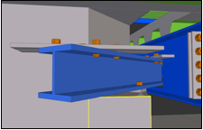
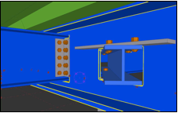
Appendix
Core Corner Details
Building Background
Building Structural System
Problem Statement
Proposed Solution
Structural Investigations
Architectural Impact
Sustainability Study
Conclusion

Slide 37
Appendix
Masses Modeled in ETABS
Building Background
Building Structural System
Problem Statement
Proposed Solution
Structural Investigations
Architectural Impact
Sustainability Study
Conclusion

Slide 38


Appendix
Steel Collar Design
Building Background
Building Structural System
Problem Statement
Proposed Solution
Structural Investigations
Architectural Impact
Sustainability Study
Conclusion

Slide 39

Appendix
Steel Collar Design
Building Background
Building Structural System
Problem Statement
Proposed Solution
Structural Investigations
Architectural Impact
Sustainability Study
Conclusion

Slide 40


Appendix
Drag Strut Design
Building Background
Building Structural System
Problem Statement
Proposed Solution
Structural Investigations
Architectural Impact
Sustainability Study
Conclusion

Slide 41

Appendix
Drag Strut Design
Building Background
Building Structural System
Problem Statement
Proposed Solution
Structural Investigations
Architectural Impact
Sustainability Study
Conclusion

